Slide 1

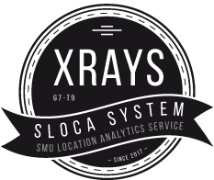
Software Engineering Final Presentation Team XRAYS (G7T9)

Slide 2
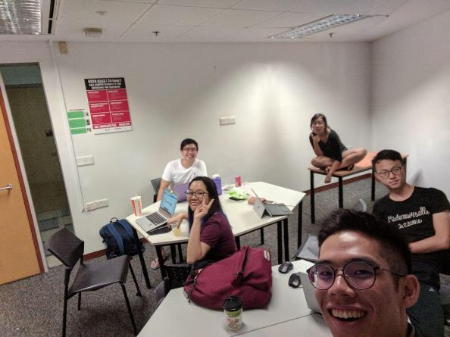
Table of contents
Schedule
Improvement
Breakdown on Work
Task and Bug Metrics
Use of GIT
Test Score
Server Info
Others
The agenda for today

Slide 3

1.
SCHEDULE
To code or not to code

Slide 4
Actual vs Planned
# | Planned | Actual
0 | 354 | 354
1 | 344 | 340
2 | 334 | 326
3 | 287 | 279
4 | 200 | 218
5 | 96 | 121
6 | 46 | 53
7 | 0 | 7

Slide 5
Planned
Basic Location Report
Heatmap
In Class Demo
Auto Group Detection
Update Sequence Diagram
4 x Debugging
2 x Integration Testing
2 x Regression Testing
Final Presentation Preparation
5 | 6 | 7
Auto Group Detection
Deployment
UAT
5 x Debugging

Slide 6
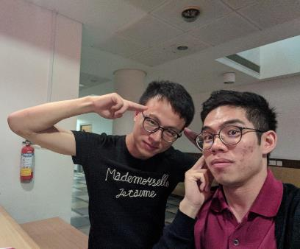
Actual
Basic Location Report
Heatmap
In Class Demo
4 x Auto Group Detection
1 x Update Sequence Diagram
4 x Debugging
2 x Integration Testing
2 x Regression Testing
Final Presentation Preparation
5 | 6 | 7
Auto Group Detection
Deployment
UAT
5 x Debugging
+ 2 x Debugging

Slide 7
Functionalities
Implemented Functionalities | Login & Logout Bootstrap & Additional Data Upload Heatmap Basic Location Report - Top K Popular Places Basic Location Report – Breakdown Basic Location Report – Top K Companions Basic Location Report – Top K Next Place Auto Group Detection
Add On Functionalities | Dashboard (Allow admin to truncate each single database table)

Slide 8
Frameworks/ External Libraries
Frontend Framework:
Bootstrap
SB Admin 2
Frontend Library
jQuery
metisMenu
Frameworks Used:
Model View Controller
(JSP Model 2)
Backend Libraries:
MySQL JDBC Driver
gson-2.8.2.jar
is203-jwt-v2.jar
json-smart-1.2.jar
nimbus-jose-jwt-2.26.1.jar
opencsv-4.1.jar

Slide 9
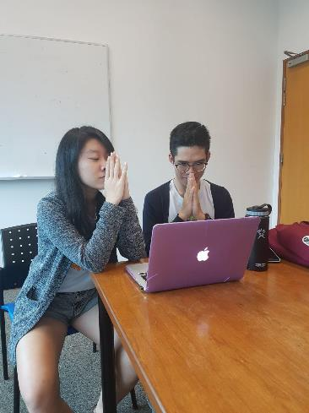
Challenges Faced
Project Manager/Leader
Being new to both the Software Engineering process and taking on the role of a project manager, there were many uncertainties and differing viewpoints. Many times the leader is just as lost as the other members but as the project manager, the leader has to come up with a game plan albeit having little to no experience and banking on a whole lot of Google and EvaLive. Given that there is no sample/model answer, we often sought other groups as point of reference and also comfort in knowing that we are on the right track.
More often than not, the programmers are waddling neck deep in codes and tend to forget to update the schedule. Therefore the Project Manager has to constantly remind the programming teams to update the schedule with the commit ID and the pair programming photos (which we didn’t realise wasn’t a requirement until Week 13). In order to ensure that the Project Manager is kept abreast of the pair programming teams’ schedule, the aid of Google Calendar was enlisted which proved to be a much needed and necessary companion in this quest to ensure that the project schedule is up to date.

Slide 10

2.
IMPROVEMENT
Improvement begins with I

Slide 11


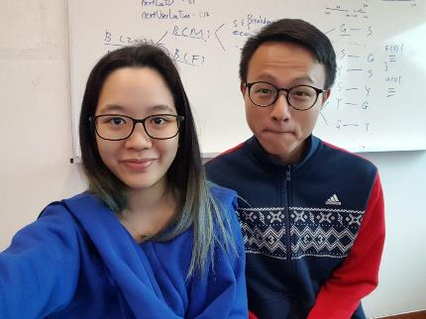
Comments We Received
Plain UI
Unbalanced Hours

Slide 12


What We Did
Plain UI
Added in preloading screen when awaiting results
PM did better job allocations this time
Unbalanced Hours
 | Xinyi | Rainean | Amos | Yigang | Samantha
Prog Hrs | 71 | 67 | 74 | 71 | 67
Non-prog Hrs | 105 | 108 | 105 | 114 | 113
Added a [Resolved On] column in bug logs for better accountability
Project Managers took a more active role by checking in with Pair Programmers
Spending more time and effort during project kickstart to iron out any possible planning issues

Slide 13
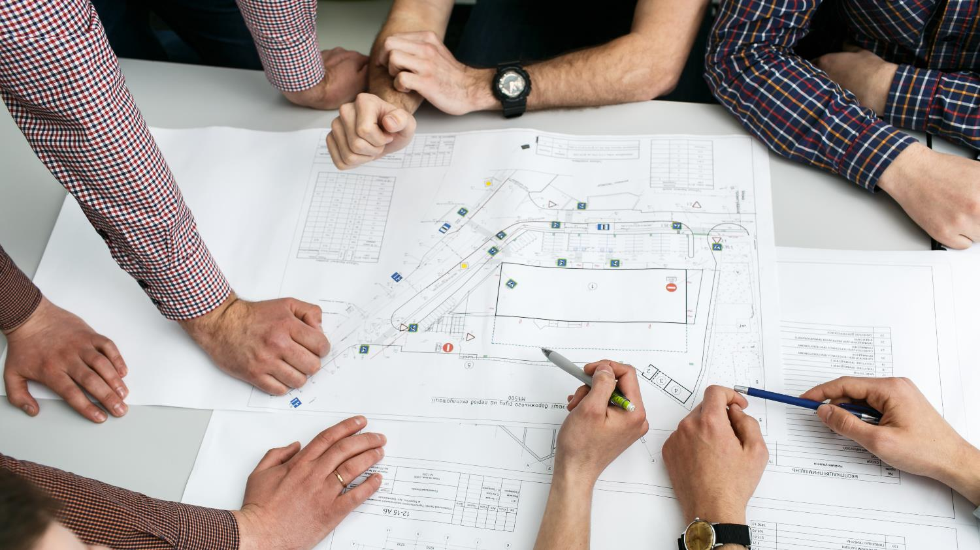
3.
BREAKDOWN OF WORK
Lets get down to business

Slide 14
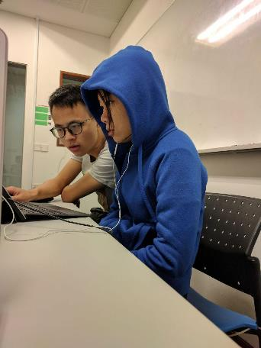
Overall Work Breakdown

Slide 15
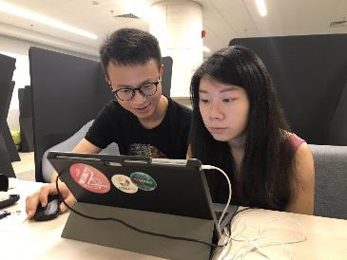
Member: Xinyi
Programming (71 Hours) | Non-Programming (105 Hours)
Bootstrap (Import & Validation) Basic Location Reports (Breakdown, Top K Companions, Top K Next Places, Top K Popular Place) System Integration Debugging | Review system design Review technical documents Preparation for Milestones (PM Review, Online Demo) Testing (Unit, System Integration, Regression) AWS Deployment

Slide 16
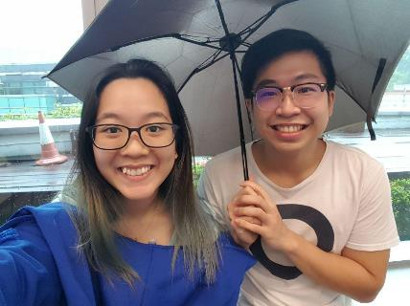
Member: Rainean
Programming (67 Hours) | Non-Programming (108 Hours)
Login Page Bootstrap (Import) Basic Location Reports (Breakdown, Top K Companions, Top K Next Places, Top K Popular Place) Integration (Top K Companions, Top K Next Places, AGD) Debugging | Review system design Review technical documents Preparation for Milestones (PM Review, Online Demo) Testing (Unit, System Integration) AWS Deployment

Slide 17
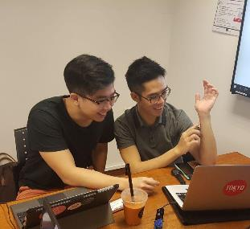
Member: Amos
Programming (74 Hours) | Non-Programming (105 Hours)
Bootstrap (Import, Validate, Logic) Login Page Basic Location Reports (Breakdown, Top K Popular Place) AGD Heatmap Debugging | Review system design Review technical documents Preparation for Milestones (PM Review, Online Demo) System Integration & Regression Testing AWS Deployment Testing (Unit, System Integration)

Slide 18
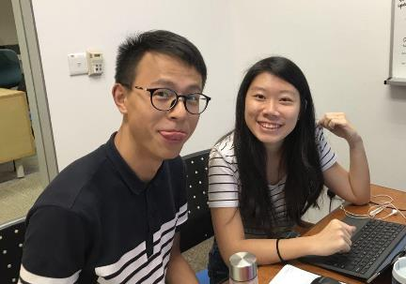
Member: Yigang
Programming (71 Hours) | Non-Programming (114 Hours)
Login Page Bootstrap (Import, Validate) Basic Location Reports (Top K Next Places, Breakdown, Top K Popular Place) Debugging | Review system design Review technical documents Preparation for Milestones (PM Review, Online Demo) AWS Deployment Create Test Cases (Bootstrap, Top K Companions, Top K Next Places) Testing (Unit, System Integration, Regression)

Slide 19
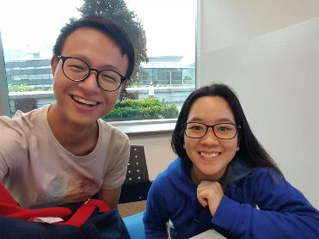
Member: Samantha
Programming (67 Hours) | Non-Programming (113 Hours)
Bootstrap (Import, Validate, Logic) Login Page AGD Heatmap Debugging | Review system design Review technical documents Create Test Case (Bootstrap) Preparation for Milestones (PM Review, Online Demo) AWS Deployment Testing (Unit, System Integration, Regression)

Slide 20

4.
TASK AND BUG METRICS
Squish Squash Squeeze

Slide 21
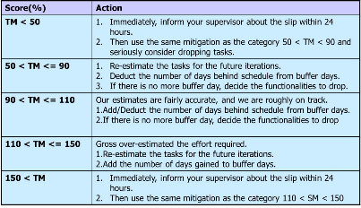
Task Metrics
# | No. of Planned tasks | No. of Actual Tasks | Score(%)
1 | 5 | 6 | 120
2 | 5 | 6 | 120
3 | 22 | 20 | 91
4 | 33 | 23 | 69. 7
5 | 50 | 46 | 92
6 | 21 | 23 | 109
7 | 16 | 16 | 1
For Iterations 1 & 2, there was gross over estimation of effort.
From this, we knew we were over allocating needed time for technical documents. Hence, in future iterations, we reduced the number of time allocated for creating technical documents.

Slide 22
Task Metrics
# | No. of Planned tasks | No. of Actual Tasks | Score(%)
1 | 5 | 6 | 120
2 | 5 | 6 | 120
3 | 22 | 20 | 91
4 | 33 | 23 | 69. 7
5 | 50 | 46 | 92
6 | 21 | 23 | 109
7 | 16 | 16 | 1
For Iteration 4, there was gross under estimation of effort.
We were complacent and underestimated the difficulty of AGD and BLR because we thought we could allocate the same time we did for login and bootstrap. Codes were then not completed on time and a lot of incomplete tasks. Hence in future iterations, we discussed the major parts of the business logic during our project kickstart and from that, we were able to better derive the estimated time taken. Furthermore, we decided to allot longer sessions for AGD and BLR as well as more sessions for the two.

Slide 23
Task Metrics
# | No. of Planned tasks | No. of Actual Tasks | Score(%)
1 | 5 | 6 | 120
2 | 5 | 6 | 120
3 | 22 | 20 | 91
4 | 33 | 23 | 69. 7
5 | 50 | 46 | 92
6 | 21 | 23 | 109
7 | 16 | 16 | 1
For Iterations 3,5,6 & 7, our estimates are fairly accurate and we are roughly on track. This goes to show that our analysis of prior iterations and discussing how we will tackle the logic of each feature at the start of each iteration paid off and that we are more in control now.

Slide 24
Task Metrics
Follow Up Actions for Most Severe Cases:
The most severe case for our team would be that of Iteration 4. Iteration 4
was the iteration where we began tackling the complicated business logic of the project. As our group kept a close eye on the Project Schedule, we saw signs of trouble when we couldn’t think of the logic for the Auto Group Detection despite our best efforts.
Halfway through the week, we decided to inform the Project Manager about this and requested to work on Heatmap instead. Thus, we added in unplanned tasks so that we could focus on working on the slightly less complicated Heatmap instead of the Auto Group Detection which was proving to be very troublesome.
Challenges Faced:
The format of the Project Schedule was not the most intuitive of tools to be used. Therefore, we took time during the initial phases of the project to take ownership of the Project Schedule by adjusting things that we could adjust.
This included adding thick black lines to demarcate boundaries between each iteration as well as changing the datetime to DD-MMM HH:mm
[4-Sep 13:00] which was much easier to read and also reduces the likelihood of us jumbling up the date and the month.
# | No. of Planned tasks | No. of Actual Tasks | Score(%)
1 | 5 | 6 | 120
2 | 5 | 6 | 120
3 | 22 | 20 | 91
4 | 33 | 23 | 69. 7
5 | 50 | 46 | 92
6 | 21 | 23 | 109
7 | 16 | 16 | 1

Slide 25

Bug Metrics
# | Score
1 | 0
2 | 0
3 | 21
4 | 34
5 | 63
6 | 61
7 | 0
For Iterations 1 & 2, there were no bugs due to these 2 iterations being mainly creating of technical documents and programming was done in silos without nothing substantial to test. Therefore the Scores were 0 and there was nothing to be done.
For Iteration 7, we resolved all bugs that were identified. This being the last iteration of the project, there was nothing to be done.

Slide 26
Bug Metrics
# | Score
1 | 0
2 | 0
3 | 21
4 | 34
5 | 63
6 | 61
7 | 0
For Iterations 3,4,5,6 & 7 there were far more bugs being found. This resulted in us using our scheduled buffer time to take care of them. However for those which overflowed, the subsequent Project Manager planned for a debugging session to take care of these bugs before planning other more tasks.
The goal here was to take care of the critical bugs before carrying on to other parts of the project. We made use of the Bug Severity score to prioritize which bugs to take care of first which made it easier to move on from there.

Slide 27
Bug Metrics
Follow Up Actions for Most Severe Cases:
The most severe cases for our team would be that of Iteration 5 and 6. This is due to the bulk of the complex codes being implemented during these 2 iterations which resulted in more cleverly hidden bugs.
Having monitored the bug log closely and seeing the number of bugs piled up and the number of debugging sessions decreasing. We quickly informed the Project Manager and requested for even more debugging sessions in the following iterations after having exhausted the buffer we had.
Challenges Faced:
As beginners to the whole Software Engineering process, almost every member of the team were not used to the whole process of logging bugs. For those who do log it down properly, most of it were in different formats and decipherable only by its creator.
Therefore, we had to hold a meeting to bring this up and standardize a couple of things before we could move on. This saved a lot of trouble in the later parts of the project where we had to come up with the bug metrics.
# | Score
1 | 0
2 | 0
3 | 21
4 | 34
5 | 63
6 | 61
7 | 0

Slide 28

5.
USE OF GIT
In case of fire:
Git Commit
Git Push
Leave Building

Slide 29
Pull Commit Push
Author | Commits
Xinyi | 41
Rainean | 43
Amos | 48
Yigang | 43
Samantha | 45

Slide 30
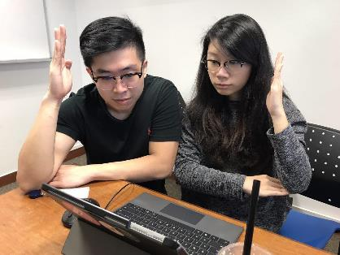
Team XRAYS Git 101
Step 1
Ensure that work is completed before committing
Step 2
Test before you commit
Step 3
Commit regularly
Step 4
Write good commit message
Copy latest Commit ID and paste
on Project Schedule
Step 5

Slide 31

6.
TEST SCORE
42: The answer to life

Slide 32

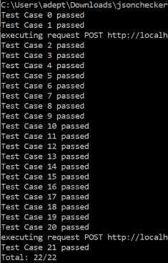

Our Results
Manual UAT Testing
24/24
JSON Automated UAT Testing
22/22

Slide 33

6.
SERVER INFO
Bitnami

Slide 34


SLOCA App
Site Details
IP Address | http://52.221.242.151
Web URL | http://52.221.242.151/app/login.jsp
Login Credentials
Username | admin
Password | pxraysw

Slide 35

7.
OTHERS
Any other business

Slide 36


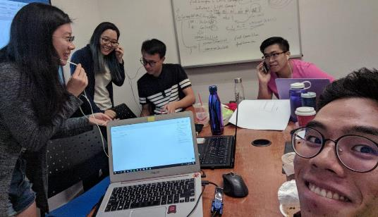
Main Takeaways
If you want to go fast, go alone.
If you want to go far, go together.
Communication
A concept that is always brought up but easily forgotten. Communication is key to any successful relationship and our team has learnt the importance of saying what is on our mind; in a polite way of course. This has allowed us to trust each and made our teamwork stronger.
Assumptions
In a project with many uncertainty, the path of least resistance will be to assume and think about it later. However, this strategy has cost us dearly and taught us to never assume. Always double check.

Slide 37


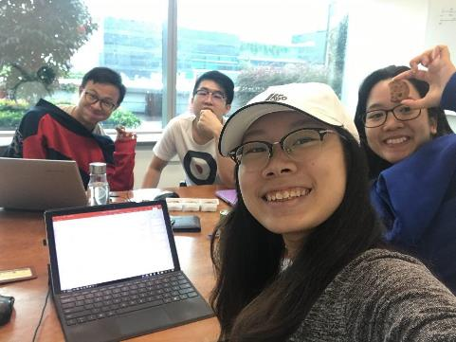
Conflict Management
Peace is not absence of conflict, it is the ability to handle conflicts by peaceful means ~ Ronald Reagan
Listening
Conflicts are necessary in order to produce innovative solutions. We have learnt to first listen before providing an objective response. Being open minded and willing to listen to others opinions and consider the fact that you may be wrong has allowed us to spend on time on quality work rather than senseless argument
Swear Jar
Having a swear jar in placed has made the environment a much more candid one. Albeit annoying at times, the jar has helped to further bond the team together. It is rather amusing that more attention is paid to the Swear jar rather than the Bug logs

Slide 38
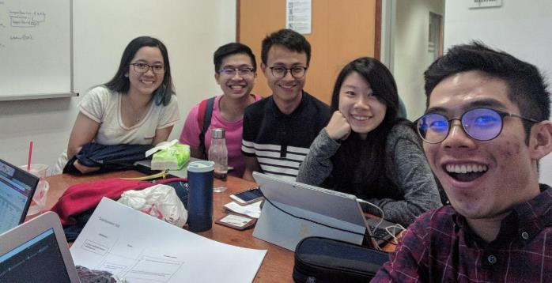
Something Interesting
Profanities
One of our dear members has contributed up to $20 to the Swear jar. Yet one member has yet to swear/come late during this project. Surely someone is gaining from this exchange.
The number of people in your house
It is unthinkable that you will not know the number of people in your house. However that doesn’t seem to be the case for one of our foreign friends. Either it is a trend not to know or he really doesn’t care.
Red
Also a colour found in our food establishment of choice, Tea Party is the ideal energy booster Team XRAYS partakes in almost religiously.

Slide 39

Thank you very much for your time
If you have any questions about this document please don’t hesitate to contact us at:
EvaLive :D
Images referenced from Freepik.com

